Slide 1

Polynomial and exponential growth

Slide 2
Introduction
In this topic, we will
  Consider how we need to analyze and find the polynomial growth of data an^{b} or O(n^{b})
  Walk through an example
  Consider how we need to analyze and find exponential growth or decay of data ae^{bn}
  Walk through an example

Slide 3
Fitting a polynomial
Recall that you can fit a polynomial to data
T
n

Slide 4
Fitting linear combinations of functions
You can also fit any linear combination of functions:
T = a + b ln(n)
T
n

Slide 5
Other forms of data
Consider these situations:
  Your run-time shows polynomial growth with respect to capacity:
  T(n) = an^{b} + o(n^{b})
  Your data is growing or decaying exponentially over time:
  y(t) = a e^{bt}
It is important to note:
  Neither of these is in the form a₁x + a₀
  In the first case, if y = a x^{b}, then
  ln(a x^{b}) = ln(a) + b ln(x)
  In the second case, if y = a e^{bx}, then
  ln(y) = ln(a e^{bx}) = ln(a) + bx

Slide 6
Polynomial growth
Polynomial growth is described by any function that is O(n^{d})
  Suppose you’ve just implemented a bi-parental heap that contains n items
    You know that certain operations are
  You just authored the Karatsuba algorithm for multiplying two n-digit integers
    You know the run time must be

Slide 7
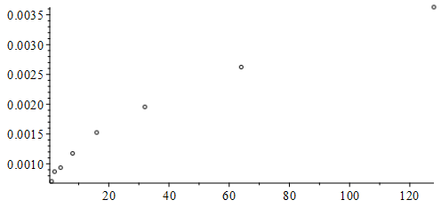
Polynomial growth
So, you time your operation on the bi-parental heap for various values of n = 2^{k} items contained in the container
  It looks like but is it O(n^{2/3})?
  We should find the best fitting T(n) = an^{b} and see if b ≈ 0.5

Slide 8
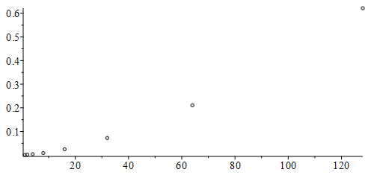
Polynomial growth
Alternatively, you try your integer multiplication routine with some large-integer class with integers of n = 2^{m} digits
  It looks like but is it O(n²)?
  We should find the best fitting T(n) = an^{b} and see if b ≈ 1.585

Slide 9
Polynomial growth
Alternatively, suppose you’ve implemented a new algorithm and you’d like to determine the asymptotic behavior
T
T(n) = an^{b}
n

Slide 10
Polynomial growth
Suppose data has polynomial growth, so
  Therefore, for larger values of n_{k}, we have
  Thus, taking logarithms of both sides yields

Slide 11
Polynomial growth
Let’s try this out:
>> ns = [1 2 4 8 16 32 64 128 256 512 1024];
>> Ts = 5.32*ns.^1.35;
>> plot( ns, Ts, 'o' );

Slide 12
Polynomial growth
Let’s try this out:
>> ns = [1 2 4 8 16 32 64 128 256 512 1024];
>> Ts = 5.32*ns.^1.35;
>> plot( log( ns ), log( Ts ), 'o' );
  The slope of the
  line is 1.35
  The y-intercept
  is ln(5.32)
  Recall that log(x)
  is the natural
  logarithm ln(x)
  log2(x)
  log10(x)

Slide 13
Polynomial growth
How can we use this?
  You have authored your algorithm and run it on various input sizes (values of n) and recorded the run time
  Two issues:
    Your program is not running in exactly in an^{b} time
      It will be an^{b} + o(n^{b}), so a log-log plot will not be a straight line
    There will be noise in your timings

Slide 14
Polynomial growth
Step 1: Collect data
  Use exponentially growing values of n = 2^{k} for k = 0, 1, 2, 3, …, N_{max}
  and record the time T_{k} for n = 2^{k}
    Try to get as many points as is reasonable,
    so sizes up to n = 2¹⁶ or more (N_{max} ≥ 16)
      This ensures lower-order terms are overwhelmed by the dominant term
    If the run time is too large for problems of size n = 2¹⁶,
    use or even
  Gather at least two sample run times per n,
  as each sample will likely have some error in the timing
    With three samples, we will have T_{k,1}, T_{k,2} and T_{k,3}
    You cannot determine error from a single sample

Slide 15
Polynomial growth
For example, if the algorithm is Gaussian elimination and backward substitution, we may be able to deduce that the average run time is
  If n = 10,
  the higher-order term is just twice the lower-order terms
  If n = 100,
  the higher-order term is 23.5 times the lower-order terms
  In the limit, the higher order term will be
  0.24n times the lower-order terms

Slide 16
Polynomial growth
For example:
T
n

Slide 17
Polynomial growth
Step 2: Analysis
  Plot a log-log plot of log(2^{k}) versus log( T_{k, j} )
  It doesn’t matter the base of the logarithm,
  so long as both are the same
    If you use a base-2 logarithm, the powers of two are integers
    Recall that lg(n) often represents log₂(n)
  Determine visually if it appears in the limit to be a straight line
    If it isn’t, you may have exponential growth or decay!
  Determine at which point it seems that the effect of the lower-order terms (the o(n^{b}) component) has diminished impact

Slide 18
Polynomial growth
For example:
lg(T)
N_{min}
lg(n)
N_{max}

Slide 19
Polynomial growth
Step 3: Linear regression
  On those points you
  determined were reasonable,
  preform a linear regression
  Solve

Slide 20
Polynomial growth
For example:
lg(T)
lg(T) ≈ 1.572 lg(n) – 4.325
N_{min}
lg(n)
N_{max}

Slide 21
Polynomial growth
Thus, if lg(T) ≈ 1.572 lg(n) – 4.325, it follows
      T = 2^{lg(T)} ≈ 2^{1.572 lg(n) – 4.325}
      = 2^{1.572 lg(n)} 2^{–4.325}
      ≈ n^{1.572} 0.04989
      = 0.04989 n^{1.572}
T
n

Slide 22
Exponential growth or decay
Exponential growth is described by any function that is Θ(e^{bn})
  This includes radioactive decay
  It also describes exponential growth:
    Moore’s law says that the number of transistors in a dense integrated circuit doubles every at two years since 1970
    I found a paper by Anthony Ricciardi and Rachael Ryan:
      The exponential growth of invasive species denialism
      This is number of years since 1990

Slide 23
Exponential growth or decay
Suppose you are counting the number hives of Asian giant hornets found in North America
C
C(n) = ae^{bn}
n

Slide 24
Exponential growth or decay
Suppose data has exponential growth or decay, so
  Therefore, for various values of n_{k}, we have
  Thus, taking logarithms of both sides yields

Slide 25
Exponential growth or decay
Let’s try this out:
>> ns = 0:10;
>> Cs = 8.23*exp( -0.2*ns );
>> plot( ns, Cs, 'o' );

Slide 26
Exponential growth or decay
Let’s try this out:
>> ns = 0:10;
>> Cs = 8.23*exp( -0.2*ns );
>> plot( ns, log( Cs ), 'o' );
  The slope of the
  line is –0.2
  The y-intercept
  is ln( 8.23 )

Slide 27
Exponential growth or decay
How can we use this?
  You have collected your data and you understand it to be growing or decaying exponentially
  Two issues:
    There will be noise in your data
    There may be other factors

Slide 28
Exponential growth or decay
Step 1: Collect data
  Use different values of (n₀, C₀), (n₁, C₁), (n₂, C₂), …, (n_{N}, C_{N}),
    Try to get as many points as is reasonable
    Equally spaced points are common, but not required
    Often n₀ = 0, but this is not required
  If possible, gather at least two samples per n,
  as each sample will likely have some error in the count
    With three samples, we will have C_{k,1}, C_{k,2} and C_{k,3}
    You cannot determine error from a single sample

Slide 29
Exponential growth or decay
For example:
C
n

Slide 30
Exponential growth or decay
Step 2: Analysis
  Plot a semi-log plot of n_{k} versus ln( C_{k, j} )
  It doesn’t matter the base of the logarithm,
  so long as we use the same base later
  Determine visually if it appears to be a straight line
    If it isn’t, you may have polynomial growth or decay!

Slide 31
Exponential growth or decay
For example:
ln(C )
n

Slide 32
Exponential growth or decay
Step 3: Linear regression
  On those points you
  determined were reasonable,
  preform a linear regression
  Solve

Slide 33
Exponential growth or decay
For example:
ln(C )
lg(C) ≈ 1.572 – 0.235n
n

Slide 34
Exponential growth or decay
Thus, if ln(C) ≈ 1.572 – 0.235n, it follows
      C = e^{ln(C)} ≈ e^{1.572 – 0.235n}
      = e^{1.572} e^{– 0.235n}
      ≈ 4.816 e^{– 0.235n}
  We can also find the half-life by solving e^{–0.735n} = 0.5
  Thus, the half life is n_{½} = – ln(0.5)/0.235 = 2.9496
C
n

Slide 35
Exponential growth or decay
If the data was exponentially growing:
  The coefficient b > 0
  You can calculate the doubling time by solving e^{bn} = 2 once you have estimated b

Slide 36
Polynomial-logarithmic growth
What do we do about growth that are in these forms?
T = an^{b} ln(n) or T = an^{b} ln^{c}(n)
  Problem: ln(n) = o(n^{b}) for any b > 0
  Consequently, you could do the following:
ln(T) = ln(a) + b ln(n) + ln(ln(n))
ln(T) – ln(ln(n)) = ln(a) + b ln(n)
ln(T) = ln(a) + b ln(n) + c ln(ln(n))
  This may be useful to confirm an implementation is, say, n ln(n)
These techniques may be useful if you are testing for:
T = a ln^{c}(n)
  Thus, we would match ln(T) = ln(a) + c ln(ln(n))

Slide 37
Example 1
Suppose we have this example:
>> xs = [3 5 8 11 15 18 19 24 25]';
>> ys = [8.4 10.5 15.5 25.8 49.7 80.3 98.5 184.5 260.0]';
>> plot( xs, ys, 'o' );
  Is it growing polynomially or exponentially?

Slide 38
Example 1
Let’s plot both:
>> plot( xs, log( ys ), 'o' );
>> plot( log( xs ), log( ys ), 'o' );

Slide 39
Example 1
We can find the best-fitting exponential curve:
>> V = [ones(9,1) xs];
>> a = V \ log( ys )
a =
1.576485560599445
0.155801668985937
>> exp( a(1) )
ans = 4.837923310623190

Slide 40
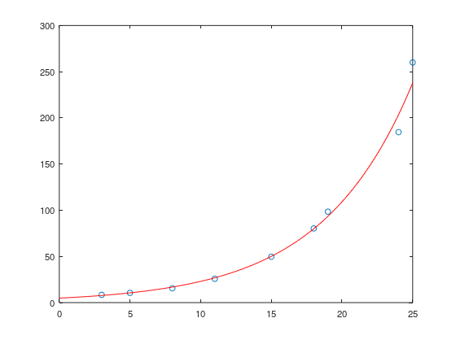
Example 1
We can now plot the data and the best-fitting exponential curve:
>> plot( xs, ys, 'o' )
>> hold on
>> xv = 0:0.1:25;
>> plot( xv, 4.8379*exp(0.1558*xv), 'r' );

Slide 41
Example 2
Suppose we have this example:
>> xs = [3 5 8 11 15 18 19 24 25]';
>> ys = [0.1 0.3 0.9 2.8 7.9 12.5 19.2 18.2 29.5]';
>> plot( xs, ys, 'o' );
  Is it growing polynomially or exponentially?

Slide 42
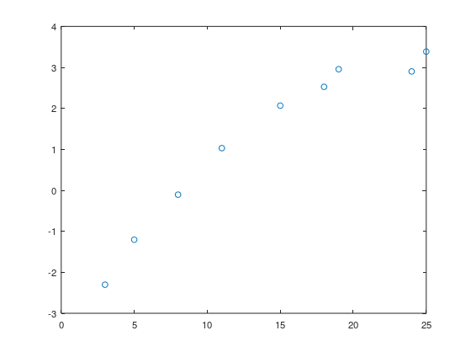
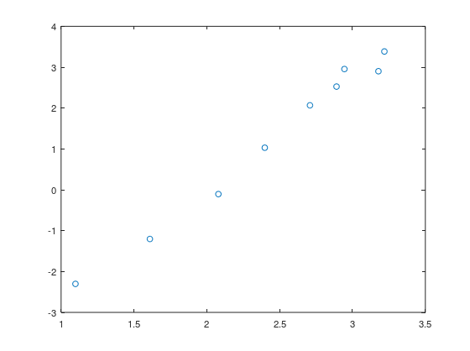
Example 2
Let’s plot both:
>> plot( xs, log( ys ), 'o' );
>> plot( log( xs ), log( ys ), 'o' );

Slide 43
Example 2
We can find the best-fitting polynomial curve:
>> V = [ones(9,1) log( xs )];
>> a = V \ log( ys )
a =
-5.519325745036392
2.753647782022680
>> exp( a(1) )
ans = 4.008549815722325e-03

Slide 44
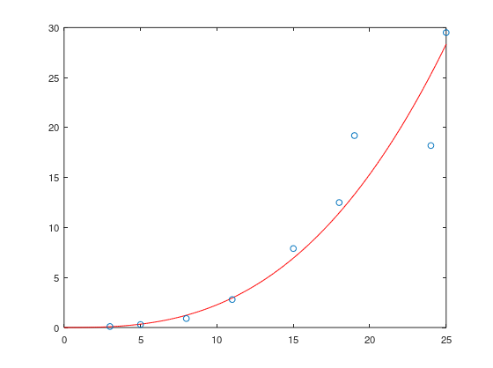
Example 2
We can now plot the data and the best-fitting exponential curve:
>> plot( xs, ys, 'o' )
>> hold on
>> xv = 0:0.1:25;
>> plot( xv, 0.004009*xv.^2.7536, 'r' );

Slide 45
Summary
Following this topic, you now
  Understand that you can use least-squares best-fitting linear polynomials to find both polynomial and exponential growth
  Know the data may be transformed to being linear by:
    Taking the logarithm of both values for polynomial growth
    Taking the logarithm of the counts for exponential growth or decay
  Understand that using least-squares best-fitting techniques,
  this gives us the best estimates of the unknown coefficients
  Know that you can calculate the half life for exponential decay by solving e^{bn} = ½ and the doubling time by solving e^{bn} = 2

Slide 46
References
[1] https://en.wikipedia.org/wiki/Log%E2%80%93log_plot
[2] https://en.wikipedia.org/wiki/Semi-log_plot

Slide 47
Acknowledgments
None so far.

Slide 48



Colophon
These slides were prepared using the Cambria typeface. Mathematical equations use Times New Roman, and source code is presented using Consolas. Mathematical equations are prepared in MathType by Design Science, Inc.
Examples may be formulated and checked using Maple by Maplesoft, Inc.
The photographs of flowers and a monarch butter appearing on the title slide and accenting the top of each other slide were taken at the Royal Botanical Gardens in October of 2017 by Douglas Wilhelm Harder. Please see
https://www.rbg.ca/
for more information.

Slide 49
Disclaimer
These slides are provided for the ece 204 Numerical methods course taught at the University of Waterloo. The material in it reflects the author’s best judgment in light of the information available to them at the time of preparation. Any reliance on these course slides by any party for any other purpose are the responsibility of such parties. The authors accept no responsibility for damages, if any, suffered by any party as a result of decisions made or actions based on these course slides for any other purpose than that for which it was intended.

